Slide 1
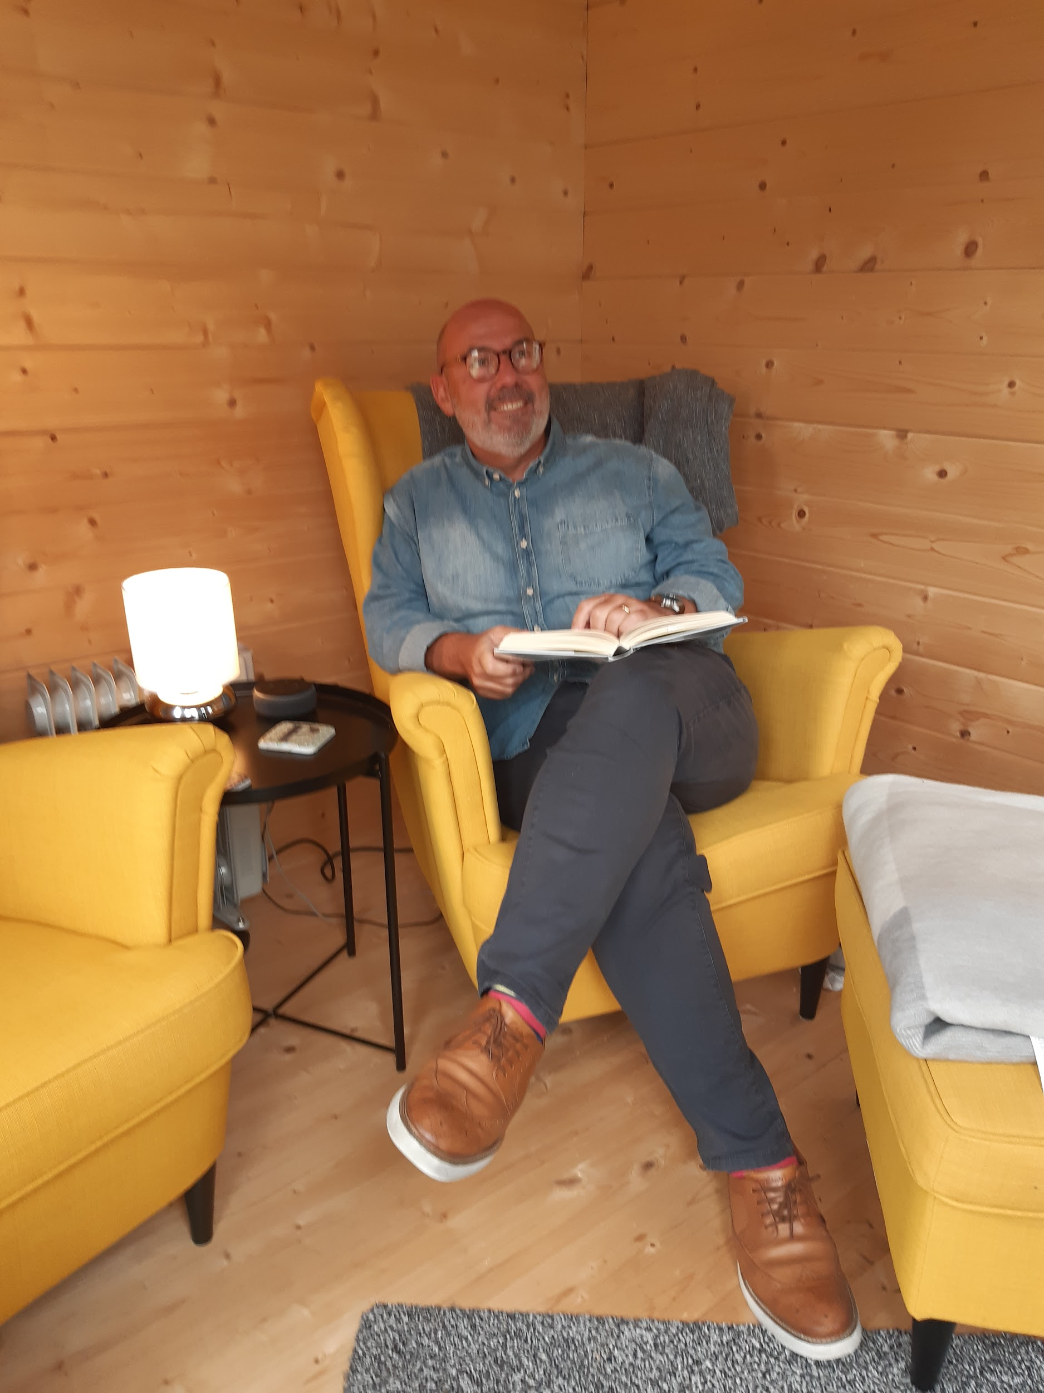
Alcohol Wellbeing
Nicky Smith
Alcohol Wellbeing Advisor
01903 221 450

Slide 2
Agenda
Welcome and Introduction
Estimate for alcohol harm across Adur & Worthing
Alcohol guidelines
Associated Health risks
Audit C
Support is available
Case study
Questions
Notes:
Welcome, Alcohol Wellbeing, who we are, what we offer and where we cover
Understanding the local estimate for alcohol harm across Adur & Worthing
Understanding alcohol guidelines / associated Health risks
Looking at Audit C (first 3 questions, who can use it and how it helps
What support is available

Slide 3
Welcome
Nicky Smith, Alcohol Wellbeing Advisor
Adur & Worthing Wellbeing, covering Adur & Worthing areas.
Alcohol Wellbeing is fully funded and commissioned by West Sussex County Council, Public Health Team.
Offering upto six, private and confidential, 121 sessions, delivered either f2f, online or via telephone. Supporting people, to better understand their relationship with alcohol and reduce alcohol.
There are further AWA in West Sussex based in Wellbeing Hubs in Arun, Chichester, Crawley, Horsham, Mid-Sussex.
Notes:
I am Nicky, Alcohol Advisor for Adur & Worthing Wellbeing
Alcohol Wellbeing has been operating across Adur & Worthing since March 2021.
Fully funded by Public Health working with WSCC/ NHS to deliver Alcohol Prevention.
We offer six one to one sessions that support alcohol reduction.
Alcohol Wellbeing are based across West Sussex Wellbeing Hubs:
Tier 2
Face to face / telephone / online sessions
Adur & Worthing
Arun
Chichester
Crawley
Horsham
Mid-Sussex
Advisors are trained in motivational interviewing supporting change behaviour, person centred delivered to support alcohol reduction/mindfulness.

Slide 4
Estimated Local Picture
Area | Non- drinkers Low Risk | Hazardous / Drinking 16.6% are drinking at hazardous levels (AUDIT score of 8-15) | Harmful Drinking / Mild Dependence 1.9% are drinking at harmful levels or are mildly dependent (AUDIT score of 16-19) | Probable Dependence 1.2% are drinking at probable dependent levels (AUDIT score of 20+)
Worthing | 75,300 | 14,000 | 1,600 | 1,000
Adur | 43,400 | 8,100 | 900 | 600
Notes:
Public Health estimate that approximately 133,600 people in West Sussex are consuming alcohol above guidelines at levels risky to their health and may benefit from support.

Slide 5
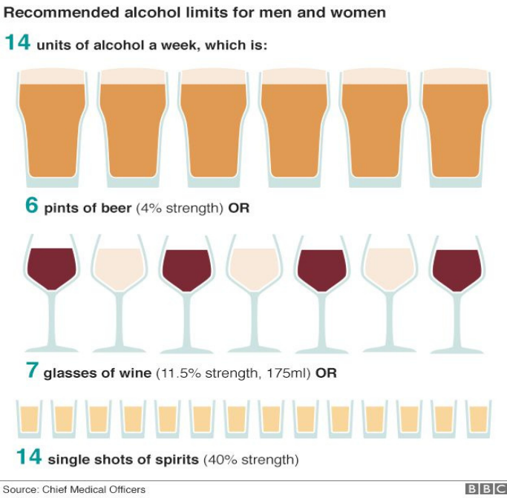
What are the Alcohol Guidelines?

Slide 6
Increased health risks from
increased alcohol intake
Condition | Men’s increased health risk (Drinking more than 50 units per week) | Women’s increased health risk (Drinking more than 30 units per week)
Hypertension (High Blood Pressure) | Four Times | Double
Stroke | Double | Four Times
Coronary Heart Disease (CHD) | 1.7 Times | 1.3 Times
Pancreatitis | Triple | Double
Liver Disease | 13 Times | 13 Times

Slide 7
Alcohol & the heart
Institute of Alcohol Studies -Alcohol & the heart explained
World Heart Federation
“Contrary to popular opinion, alcohol is not good for the heart”.
Alcohol risks:
Lifestyle choices
Smoking
Weight gain
Notes:
Institute of alcohol studies

Slide 8
Alcohol & Breast Cancer
A few Key Facts
Drinking alcohol increases the risk of breast cancer in women
and heavy drinking increases the risk in men.
Alcohol raises circulating oestrogen levels which increase breast cancer risk (14).
Alcohol can cause weight gain, increasing the risk for post-menopausal women and men.
Prevent Breast Cancer (Study) Emma Davies, Oxford Brookes University Researcher
Notes:
Prevent Breast Cancer (Study) Emma Davies, Oxford Brookes University Researcher https://www.breastcanceruk.org.uk/reduce-your-risk/alcohol-and-breast-cancer/

Slide 9
AUDIT- C
Questions | 0 | 1 | 2 | 3 | 4 | Scores
How often do you have a drink containing alcohol? | Never | Monthly or less | 2-4 Times a month | 2-3 Times per week | 4 or more times a week
How many units of alcohol do you drink on a typical day when you are drinking? | 1 - 2 | 3 or 4 | 5 to 6 | 7 to9 | 10+
How often have you had 6 or more units if female or 8 or more if male on a single occasion in the last year? | Never | Less than monthly | Monthly | Weekly | Daily or almost daily
Notes:
Scoring, a total of 5 + indicates increasing or higher risk drinking.
An overall total score of 5 or above is audit c positive

Slide 10
AUDIT
(Alcohol Use Disorders Identification Test)
Audit C
First 3 questions of the full audit
0-4 Low risk
5-7 increasing risk
8-10 higher risk
11-12 possible dependence
Full Audit
Completing all ten questions.
0-7 Low risk
8-15 Increased risk
16-19 Higher risk
20+ Possible dependence
Notes:
https://auditscreen.org/check-your-drinking/
https://drinkcoach.org.uk/alcohol-test
1st 3 questions - Scored up to 12 points
5 or more = positive screen & indicates doing a full audit
Full Audit
Completing all ten questions.
Scored upto 40 points
A total of 8 or more is a positive screen and indicates
0-7 Low risk
8-15 Increased risk
16-19 Higher risk
20+ Possible dependence

Slide 11



Reported benefits from reducing alcohol
Improved Mental Health
Access to restorative sleep (REM)
Improved
relationships

Slide 12


Reported benefits from reducing alcohol
Reduced health risks
Weight loss

Slide 13

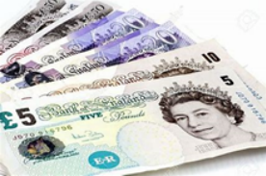

Reported benefits from reducing alcohol
Less hangovers
Saving money
Increased Energy

Slide 14
What support is available?
Health Care - Brief Intervention
GP
Pharmacist
Alcohol Liaison Nurse
Worthing Hospital /Chichester Hospital
Specialists

Slide 15
What support is available?
Tier Two Commissioned Alcohol services
Alcohol Wellbeing
Extended Brief Interventions (ebi)
up to Six Free 1 hour sessions
Drink coach Online Coaches, Alcohol Test and App and up to Six free online sessions
Audit remit 8-19 (Non dependent drinkers)
SADQ Remit 8 - 15

Slide 16
What support is available?
Tier three Services
Change grow live
Offer:
Group Work
Medical prescribing
Nurses
Audit remit 20+ Specialist Drug & alcohol service
(Dependant drinkers)

Slide 17
What support is available?
Relapse prevention
SMART Recovery
AA /CA Groups
Build on belief

Slide 18
What support is available?
National Organisations
Alcohol Change Uk
Drink Aware
Join Club Soda

Slide 19

Alcohol Assessment Telephone
EBI Session Three F2F
Area - Adur, Female, 48 yrs old, white british
Scored 18 Audit (Higher Risk Category)
Assessment Scaling questions
Mental Health 8
Physical Health 8
Over Quality of Life 10
Drinking between 7 - 13 units in drinking session and wants to no longer drink during the weekday
Client has had 14 drinking days over the last month and regular drink free days, has swapped wine to Pimms and pre-mixed G&T and choosing lower alcohol content wine.
Averaging between 20-23 units per week
EBI Session Five F2F
“Thanks for your support in this journey for me.
I feel powerful and in control”
Client is doing really well, averaging 15 drinking days and 5 units per session, has made a really good swap to G&T which feels embedded / new habit and client feels in control and much better at moderating alcohol.
EBI Session One F2F
Currently having 2 AF days per week. Recognises that she is a fast drinker and is drinking to feel relaxed. Juggling a lot of stress in personal life/family relationships/Illness. Client will start tracking her units/gather data and any themes
Mutual Exit Session Six F2F
Audit new score 12 reduction of one category
Assessment Scaling questions (Improved)
Mental Health 15 (+7)
Physical Health 13 (+5)
Over Quality of Life 13 (+3)
Referred onwards for a yearly wellbeing MOT check. Client feels comfortable around her relationship with alcohol. Is more aware and mindful, has swapped wine for mixed gin & tonic and AF products. . Average units for drinking session is now between 4-5 units.
EBI Session Two F2F
Client has increased to having 3 AF days per week. Identifying triggers and managing stress, worked through CBT sheet, to identify Thoughts, feelings, behaviours and physical response & where changes could be made.

Slide 20
Thank you
Access up to six free, 1 hour confidential EBI (extended brief interventions) sessions.
Helping you to better understand your relationship with alcohol and support for reduction.

